Slide 1
Exploring protein abundance and subcellular localization using HyperLOPIT
Olivia Rippee
Final Presentation
May 6, 2024

Slide 2
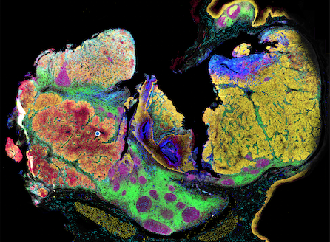
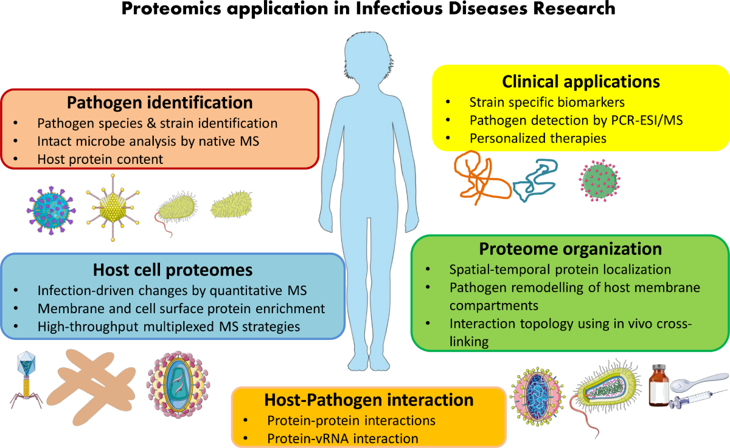
Purpose of Spatial Proteomics
Proteomics
Study of the composition, abundance, structure and function of proteins
Unlike DNA, the proteome changes depending on the cell type, tissue, and cellular activity
Spatial proteomics
Quantify protein abundance while providing information about where proteins are localized within the cell
Protein localization can provide clues about protein function and cellular organization
Health Applications
Locate problems in protein transport associated with diseases
Integrate knowledge of fundamental biology with disease

Slide 3
Spatial Proteomics Tools and Datasets in R
Main dataset
HyperLOPIT2015: a mass spectrometry-based spatial proteomics dataset containing protein abundance measurements across subcellular fractions, with known marker proteins used to represent different cellular compartments
Datasets for comparison
hyperLOPIT2015ms3r1, hyperLOPIT2015ms3r2 (hyperLOPITU2OS2018, lopitdcU2OS2018)
R packages
pRoloc: spatial proteomics analysis and visualization
pRolocdata: spatial proteomics datasets
MSnbase: mass spectrometry data structures and processing
pRolocGUI: interactive spatial proteomics visualization
rpx: access to proteomics data resources
Notes:
pRoloc/pRolocGUI/pRolocdata package
https://www.bioconductor.org/packages/release/bioc/html/pRoloc.html
https://bioconductor.org/packages/release/bioc/vignettes/pRolocGUI/inst/doc/pRolocGUI.html
RforProteomics package
https://bioconductor.org/packages/release/data/experiment/html/RforProteomics.html
Data sets: hyperLOPIT2015, hyperLOPIT2015ms3r1, hyperLOPIT2015ms3r2, lopitdcU2OS2018 (Msnbase package)

Slide 4
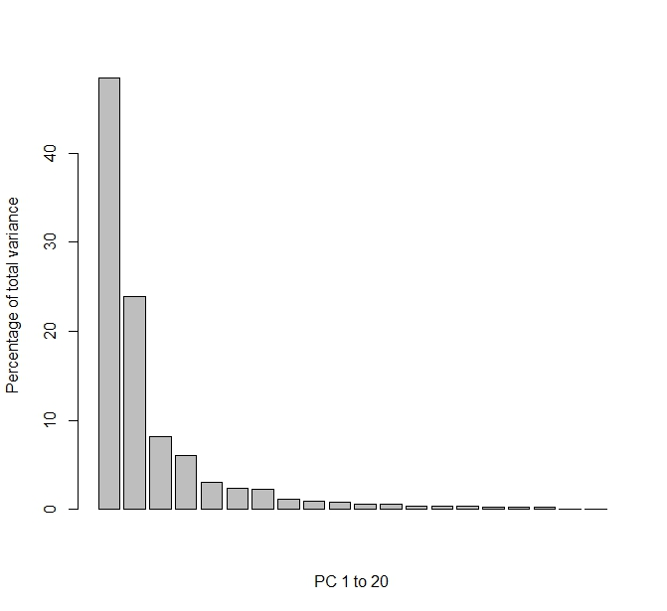
Principal Component Analysis - Dimension Reduction
PC1 captures the largest source of variation (~50%)
PC2 captures the next largest source of variation (~24%)
PC3 captures ~8%
~82% of variation accounted for by 3 variables → the first few PCs provide a useful summary of the major patterns in the spatial proteomics data
Why it matters: Simplifies complex protein data, making the major patterns in spatial organization easier to see

Slide 5
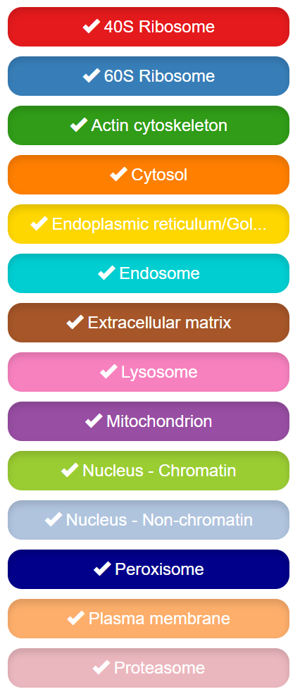
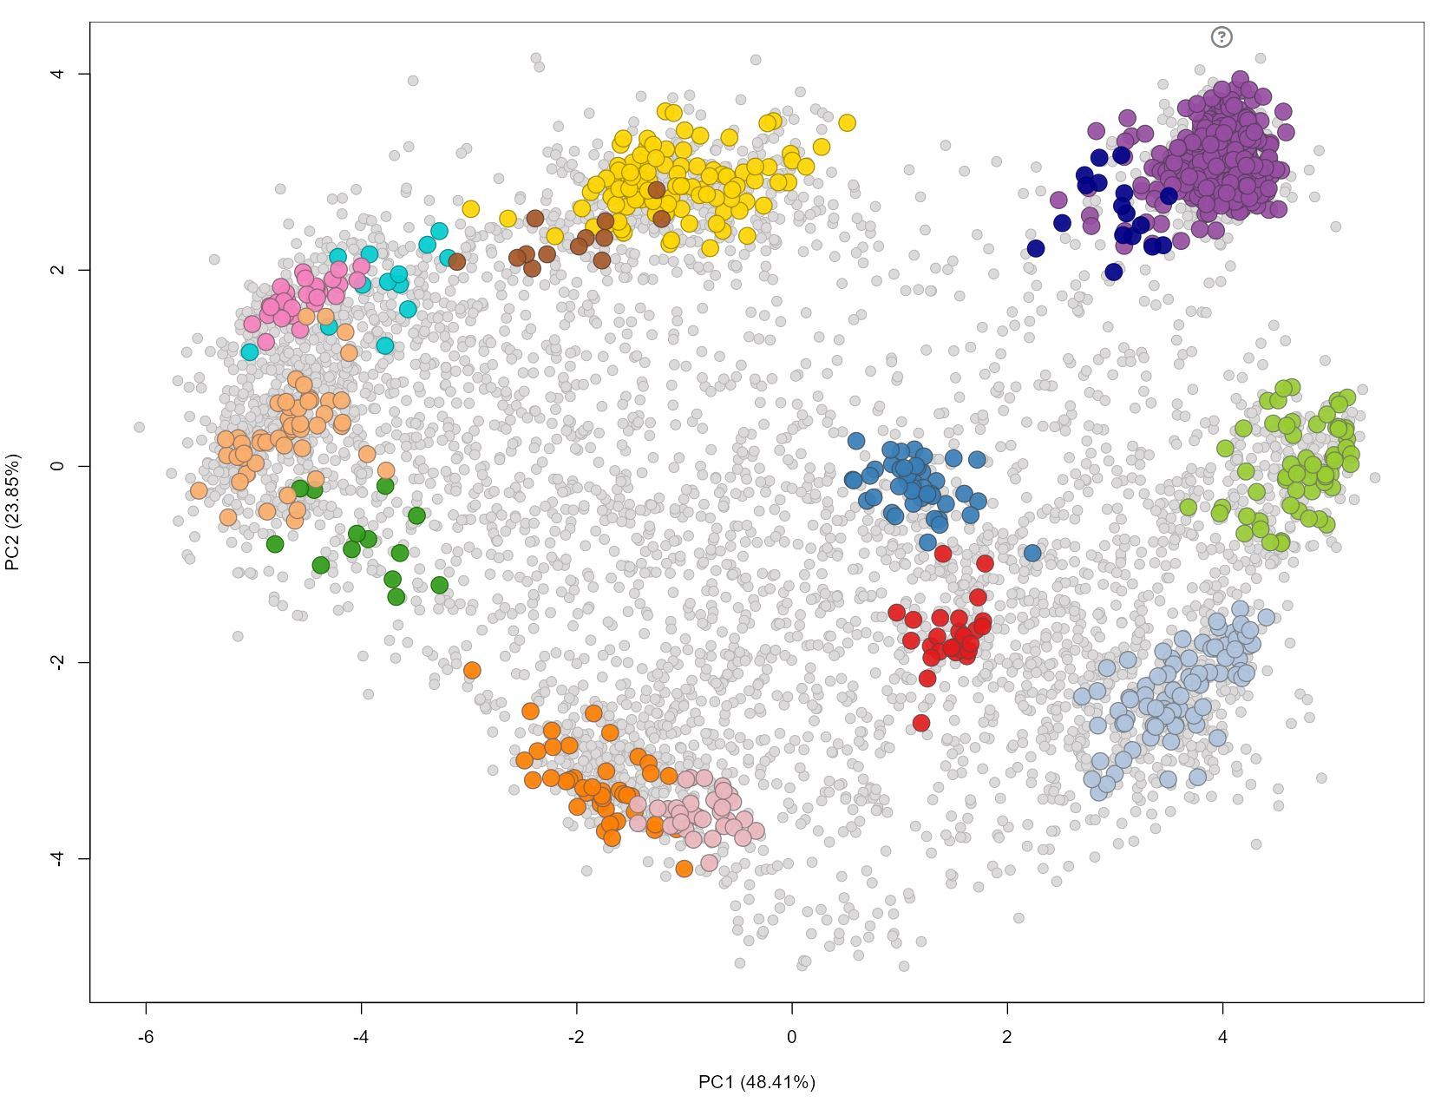
Spatial Map
Colored points = proteins with known subcellular marker annotations
Proteins with similar spatial profiles tend to appear near one another in the PCA map
Several marker groups form distinct clusters, suggesting that their protein abundance patterns across fractions are characteristic of their cellular compartments
E.g. 40S and 60S ribosome proteins cluster together – similar spatial profiles
hyperLOPIT2015

Slide 6
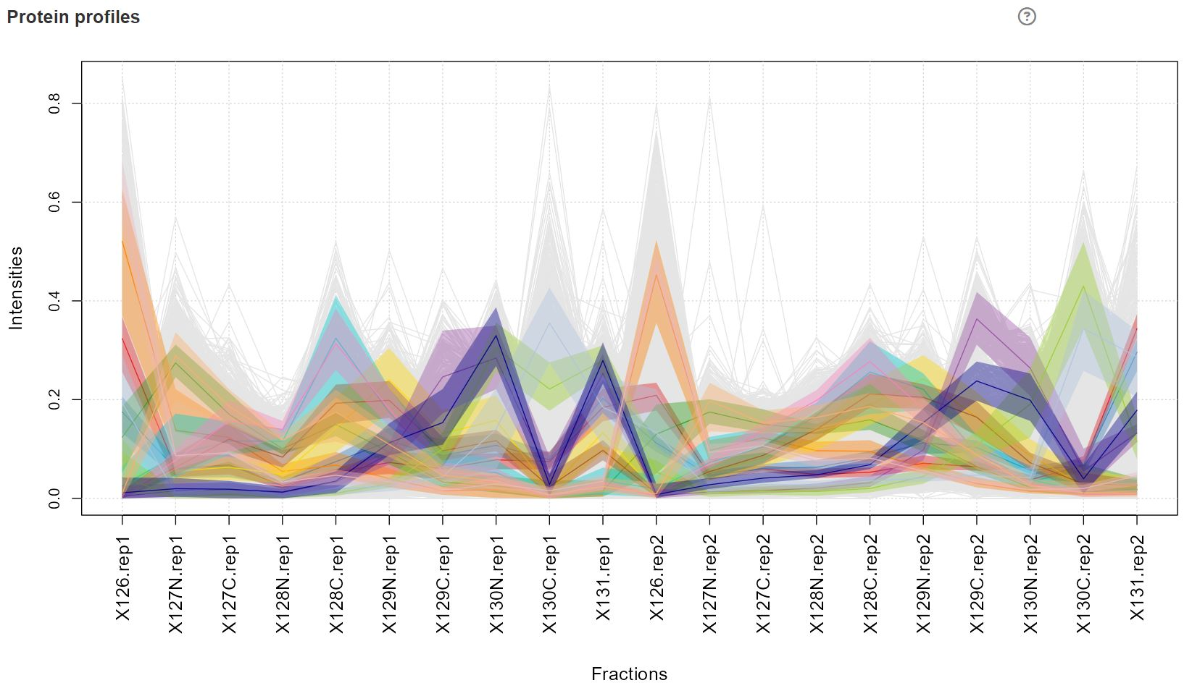
Profile Plot
Each line represents a protein abundance profile across the experimental fractions
Proteins from the same compartment tend to show similar abundance patterns across fractions
These patterns provide the information used to distinguish subcellular locations
hyperLOPIT2015
Notes:
x-axis = experimental fractions y-axis = protein intensity
The spatial map provides a 2D overview, while the profile plot shows the underlying protein distributions across fractions

Slide 7
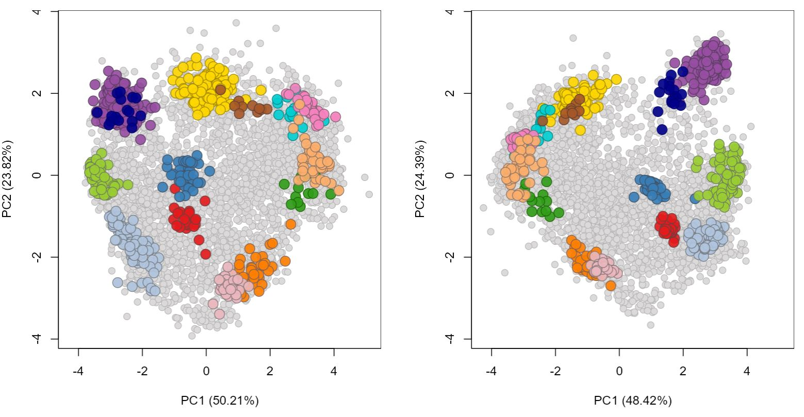
Comparison: Spatial Maps
Compare replicate datasets to assess whether spatial organization is reproducible
The two datasets show similar overall arrangements of the major subcellular marker classes
E.g. the 40S and 60S ribosome groups occupy similar regions in both datasets
hyperLOPIT2015ms3r1
hyperLOPIT2015ms3r2

Slide 8
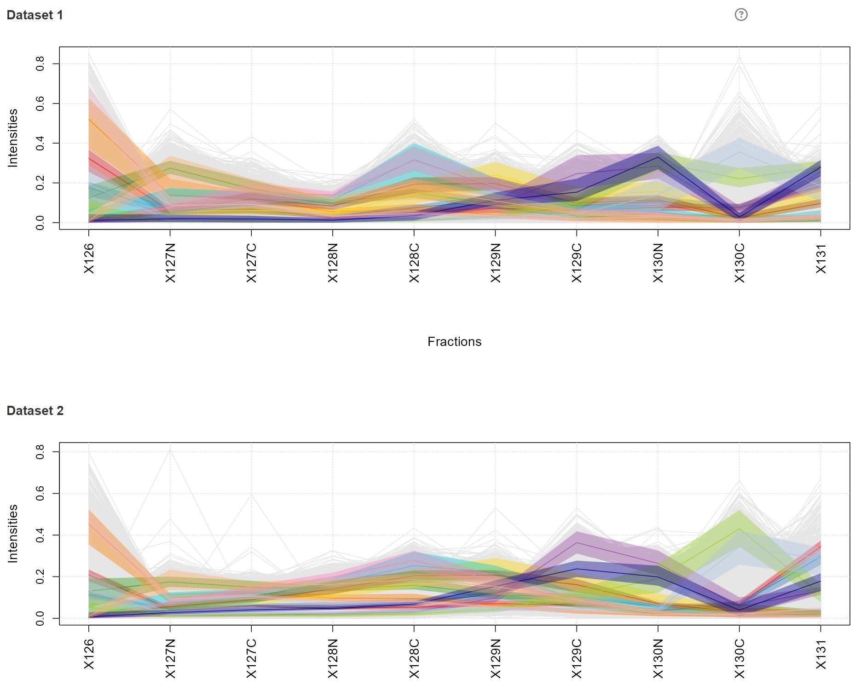
Comparison: Profile Plots
Protein intensities vary somewhat between replicates
(e.g. X130C = 0.2 in r1,
but 0.4 in r2)
However, the overall shape of the spatial profiles is similar
Similar profiles across replicates support the reproducibility of the observed spatial organization
hyperLOPIT2015ms3r1
hyperLOPIT2015ms3r2
Fractions

Slide 9
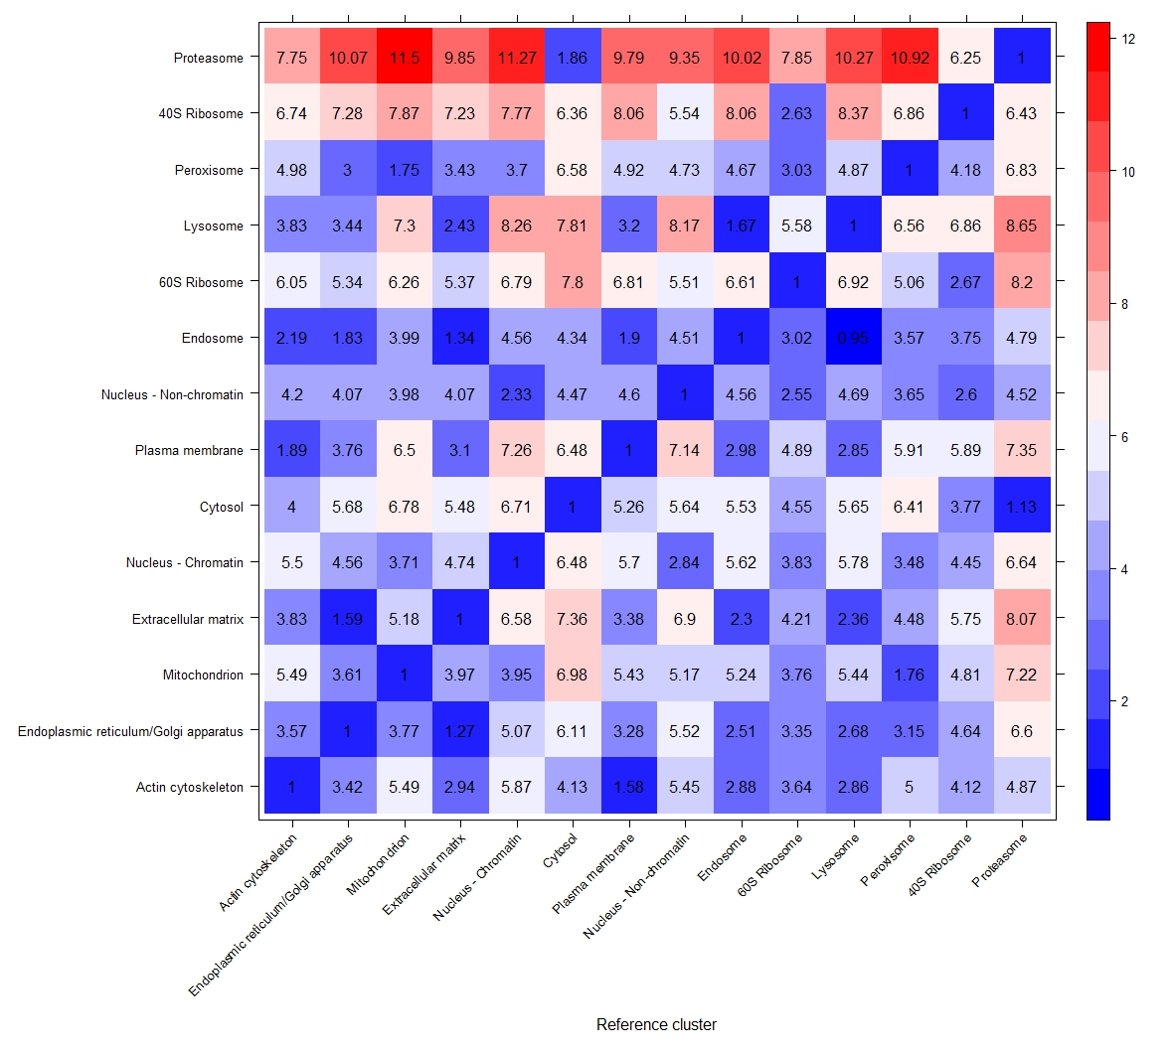
QSep Subcellular Cluster Separation
Compares the spatial profiles of known subcellular compartments
Provides a quantitative measure of how distinct the compartments are
Diagonal: within-compartment normalized distance (1)
Off-diagonal: between-compartment distance
Higher values of indicate greater profile separation relative to within-cluster variation
E.g. 40S and 60S ribosomes have a relatively low distance (~2.7) → similar spatial profiles
E.g. actin cytoskeleton and mitochondria have a much larger distance (~5.5) → more distinct spatial profiles
hyperLOPIT2015
Notes:
Location Correlation Heatmap

Slide 10
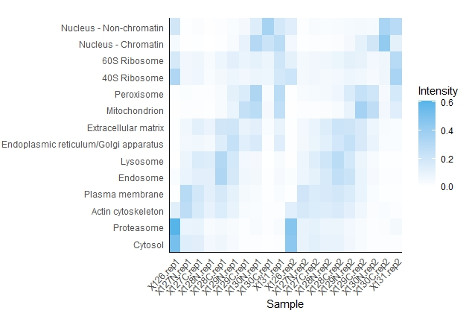
Subcellular Location Profiles Across Fractions
hyperLOPIT2015
Each row represents the average abundance profile of proteins associated with that compartment
Similar patterns across fractions indicate similar spatial profiles
Different compartments show different abundance patterns across the fractions, providing a spatial signature for each cellular location
40S and 60S ribosomes show similar patterns across fractions (consistent with their relationship in the spatial map and profile plot)

Slide 11
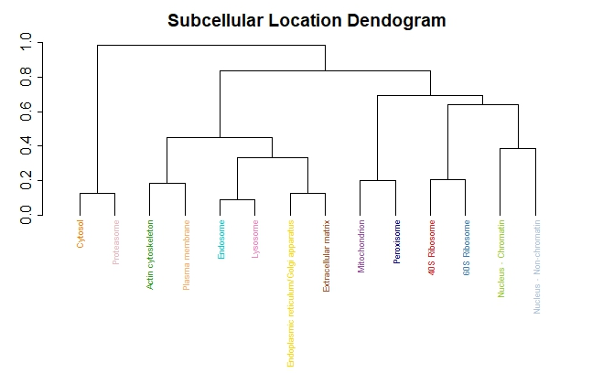
Hierarchical Clustering of Subcellular Locations
Compartments (subcellular locations) that join together at shorter distances have more similar average protein profiles
The dendrogram groups compartments based on similarities in their spatial profiles
Similar spatial protein profiles:
40S and 60S ribosomes
Endosome and lysosome
Cytosol and proteasome
hyperLOPIT2015

Slide 12
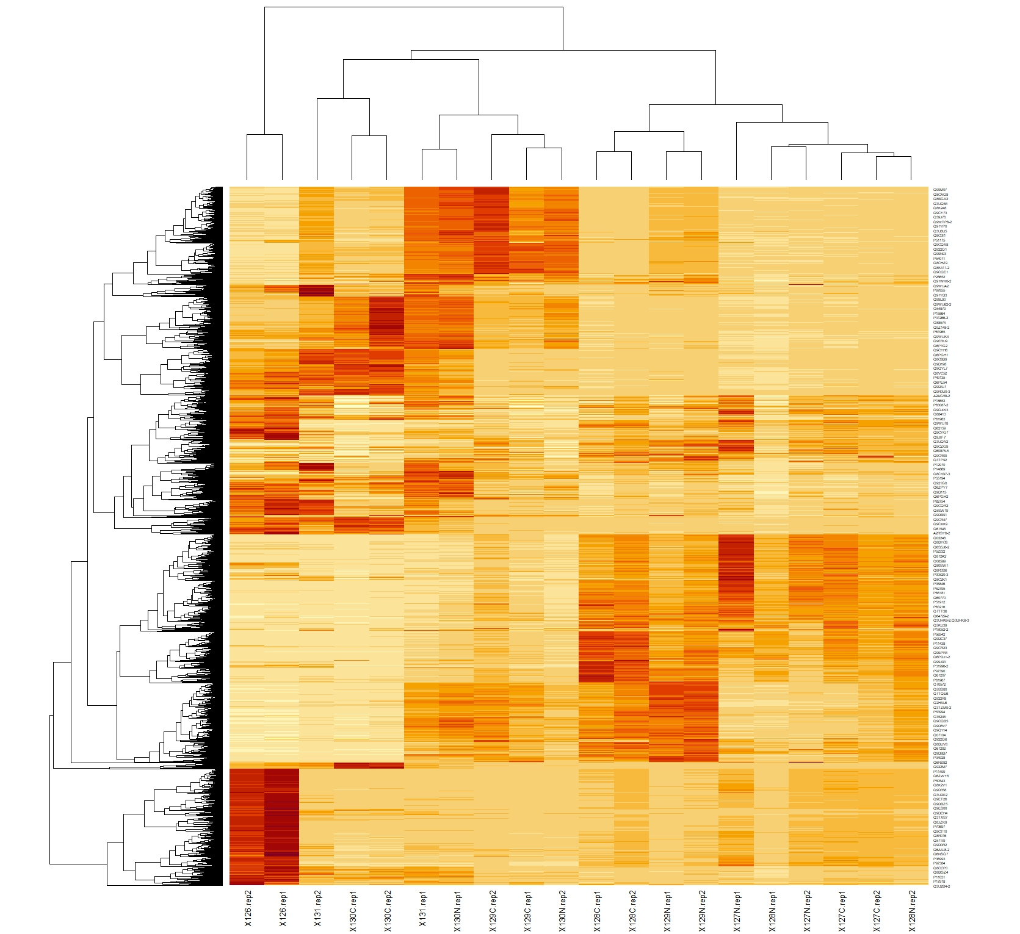
Protein Abundance Heatmap
hyperLOPIT2015
Visualizes protein abundance across HyperLOPIT fractions
Rows = individual proteins
Columns = experimental fractions
Color intensity = relative abundance
Clustering groups proteins with similar abundance patterns
Reveals patterns that can help distinguish subcellular localization

Slide 13
Protein Abundance Heatmap
hyperLOPIT2015
Selected Examples (OMIM Search)
Q99M07 = Coa5 [Uniprot]
Function: involved in an early step of the mitochondrial complex IV assembly process
Disease: Mitochondrial complex IV deficiency (MC4DN9; 616500) → fatal infantile cardioencephalomyopathy [OMIM]
P56480 = Atp5f1b [Uniprot]
Function: Mitochondrial membrane ATP synthase
Disease: uncoupled mitochondrial oxidative phosphorylation-2 (HUMOP2; 620085) → hypermetabolism [OMIM]
Notes:
Uniprot IDs → gene names → OMIM disease search
Similar profiles → similar location → similar function

Slide 14
Key Takeaways
HyperLOPIT data reveal distinct spatial patterns of protein abundance across subcellular compartments
Known marker proteins form recognizable spatial clusters, supporting the ability to distinguish cellular locations
PCA summarizes the major sources of variation in the spatial proteomics dataset
QSep and hierarchical clustering show that some subcellular compartments have more similar spatial profiles than others
Replicate HyperLOPIT datasets show similar spatial organization, supporting reproducibility of the observed patterns
Protein abundance profiles provide the underlying information used to characterize subcellular localization
Together, these analyses demonstrate how computational methods can be used to explore protein localization and cellular organization from spatial proteomics data

Slide 15
References
Al-Amrani S, Al-Jabri Z, Al-Zaabi A, Alshekaili J, Al-Khabori M. Proteomics: Concepts and applications in human medicine. World J Biol Chem. 2021 Sep 27;12(5):57-69. doi: 10.4331/wjbc.v12.i5.57. PMID: 34630910; PMCID: PMC8473418.
Gatto L, Breckels LM, Wieczorek S, Burger T, Lilley KS. Mass-spectrometry-based spatial proteomics data analysis using pRoloc and pRolocdata. Bioinformatics. 2014 May 1;30(9):1322-4. doi:10.1093/bioinformatics/btu013. Epub 2014 Jan 11. PubMed PMID: 24413670; PubMed Central PMCID: PMC3998135.
Breckels LM, Gatto L, Christoforou A, Groen AJ, Lilley KS, Trotter MW. The effect of organelle discovery upon sub-cellular protein localisation. J Proteomics. 2013 Mar 21. doi:pii: S1874-3919(13)00094-8. 10.1016/j.jprot.2013.02.019. PubMed PMID: 23523639. Gatto L.
Breckels L.M., Burger T, Nightingale D.J.H., Groen A.J., Campbell C., Mulvey C.M., Christoforou A., Ferro M., Lilley K.S. 'A foundation for reliable spatial proteomics data analysis' Mol Cell Proteomics. 2014 May 20.
Breckels LM, Holden SB, Wojnar D, Mulvey CM, Christoforou A, Groen A, Trotter MW Kohlbacher O, Lilley KS, Gatto L. Learning from Heterogeneous Data Sources: An Application in Spatial Proteomics. PLoS Comput Biol. 2016 May 13;12(5):e1004920. doi: 10.1371/journal.pcbi.1004920.
Breckels LM, Mulvey CM, Lilley KS and Gatto L. A Bioconductor workflow for processing and analysing spatial proteomics data. [version 2; peer review: 2 approved]. F1000Research 2018, 5:2926 (https://doi.org/10.12688/f1000research.10411.2).
Crook OM, Breckels LM, Lilley KS, Kirk PWD, Gatto L. A Bioconductor workflow for the Bayesian analysis of spatial proteomics [version 1; peer review: awaiting peer review]. F1000Research 2019, 8:446 (https://doi.org/10.12688/f1000research.18636.1).
Laurent Gatto and Kathryn S. Lilley. MSnbase - an R/Bioconductor package for isobaric tagged mass spectrometry data visualization, processing and quantitation. Bioinformatics 28, 288-289 (2012).
Laurent Gatto, Sebastien Gibb and Johannes Rainer. MSnbase, efficient and elegant R-based processing and visualisation of raw mass spectrometry data. bioRxiv 2020.04.29.067868; doi: https://doi.org/10.1101/2020.04.29.067868 (2020).

